Slide 2
Internetworking
Definition of Internetworking
Internetworking refers to the practice of connecting multiple networks together to form a larger network. This allows for seamless communication and data exchange between different network segments.
Significance of Internetworking
Internetworking is crucial for enabling different systems to communicate, share resources, and access information across diverse networks. It forms the backbone of the modern Internet.
Role of Routers
Routers are devices that forward data packets between computer networks. They determine the best path for data to travel and connect different networks, ensuring efficient data transmission.
Role of Switches
Switches operate within a single network and connect devices, allowing them to communicate. They manage data traffic and reduce collisions by creating separate collision domains.
Data Packet Transmission
Data packets are small units of data transmitted over a network. Internetworking facilitates the movement of these packets between networks, ensuring they reach their intended destination.
Real-World Example
Consider a company with multiple branch offices. Internetworking allows employees in different locations to access shared resources, communicate via email, and collaborate on projects seamlessly.
Summary
Internetworking is essential for modern communication, enabling connectivity between various networks and devices, and is facilitated by routers and switches.

Slide 3
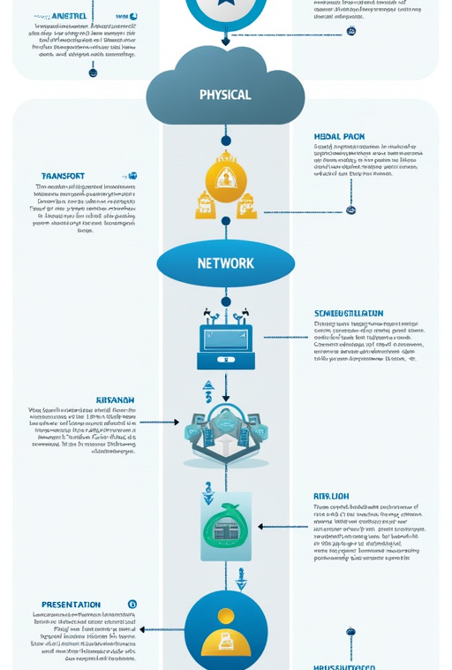
Understanding the OSI Model
Introduction to the OSI Model
The OSI (Open Systems Interconnection) model is a conceptual framework that standardizes the functions of a networking system into seven layers, promoting interoperability between different systems.
Purpose of the OSI Model
The OSI model provides a systematic approach to understanding how data is transmitted across networks. It helps in troubleshooting communication issues by isolating problems to specific layers.
Layers of the OSI Model
The OSI model consists of seven layers: Physical Layer: Handles the physical connection between devices. Data Link Layer: Manages data transfer between adjacent network nodes. Network Layer: Responsible for routing data packets across networks. Transport Layer: Ensures reliable data transfer between hosts. Session Layer: Manages sessions between applications. Presentation Layer: Translates data formats for the application layer. Application Layer: Interfaces directly with end-user applications.
Importance of Each Layer
Each layer serves a specific function, and understanding these functions is crucial for network design and troubleshooting.
Summary
The OSI model is a vital framework for understanding networking, providing a structured approach to data communication and problem-solving.
Visual Representation
A diagram of the OSI model can help visualize how the layers interact and the protocols associated with each layer.

Slide 4
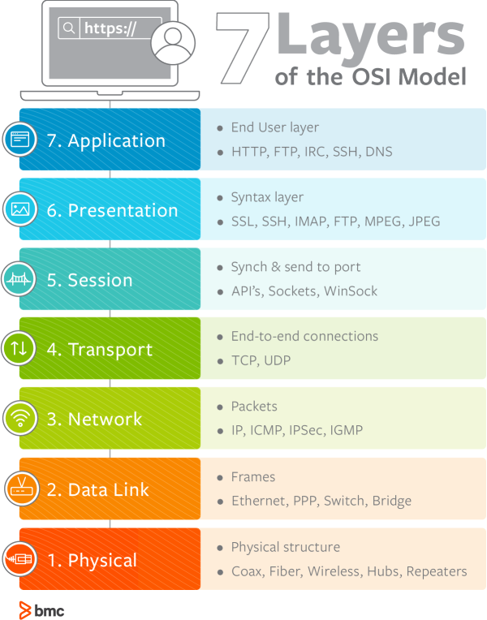
OSI Model Layers Explained
Physical Layer
The Physical layer defines the hardware elements involved in data transmission, including cables, switches, and network interface cards. It specifies how bits are transmitted over a physical medium.
Data Link Layer
The Data Link layer ensures error-free data transfer between two directly connected nodes. It uses MAC addresses to identify devices and frames to encapsulate data.
Network Layer
The Network layer is responsible for determining the best path for data to travel across networks. It uses logical addressing (IP addresses) to route packets.
Transport Layer
The Transport layer manages end-to-end communication, ensuring complete data transfer through error detection and correction. It uses protocols like TCP and UDP.
Session Layer
The Session layer establishes, maintains, and terminates connections between applications. It manages sessions and controls data exchange.
Presentation Layer
The Presentation layer translates data formats, ensuring that data is presented in a readable format for the application layer. It handles encryption and compression.
Application Layer
The Application layer is the closest layer to the end user, providing network services to applications. It includes protocols like HTTP, FTP, and DNS.

Slide 5
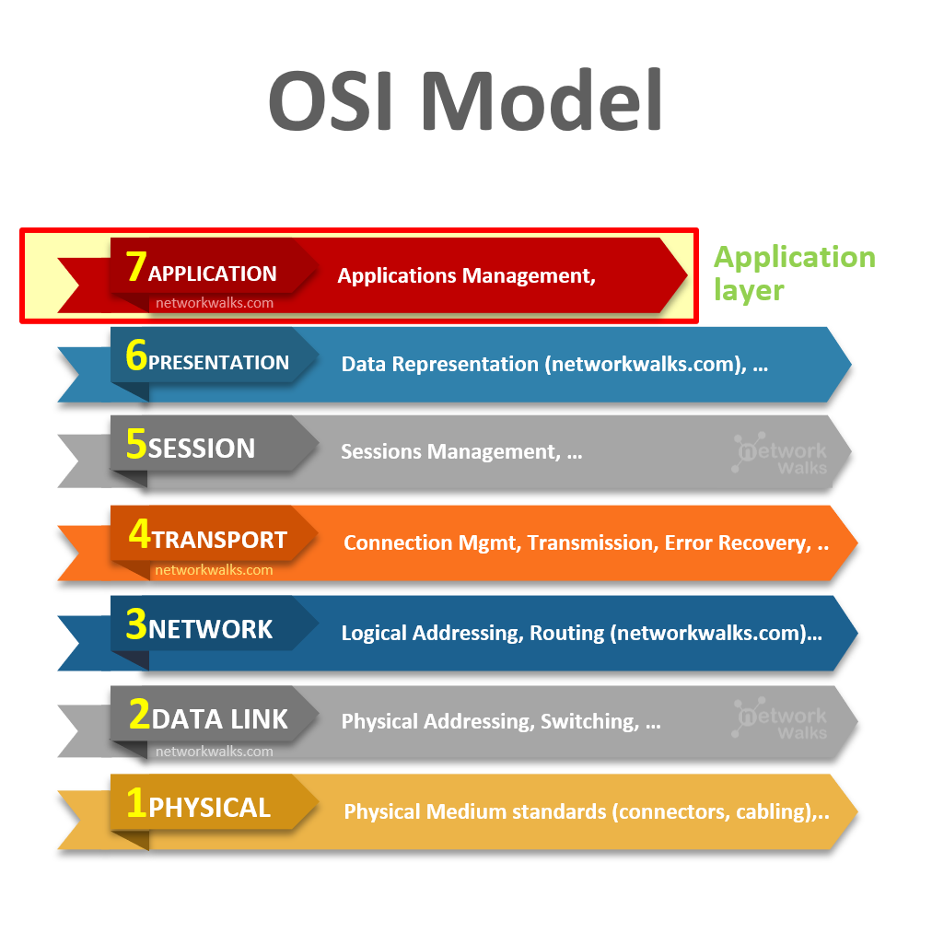
OSI Model and Real-World Applications
Real-World Applications of the OSI Model
The OSI model is applied in various real-world scenarios, guiding network design, implementation, and troubleshooting processes.
Network Design
Network engineers use the OSI model to create robust network architectures, ensuring each layer is properly addressed and configured for optimal performance.
Troubleshooting
Technicians rely on the OSI model to diagnose network issues. By isolating problems to specific layers, they can quickly identify and resolve issues, minimizing downtime.
Development of New Protocols
The OSI model serves as a reference for developing new protocols, ensuring compatibility and interoperability with existing systems.
Training and Education
The OSI model is a foundational concept taught in networking courses, helping students and professionals understand the complexities of network communication.
Summary
The OSI model's practical significance extends to network design, troubleshooting, protocol development, and education, making it an essential framework in the field of networking.

Slide 6
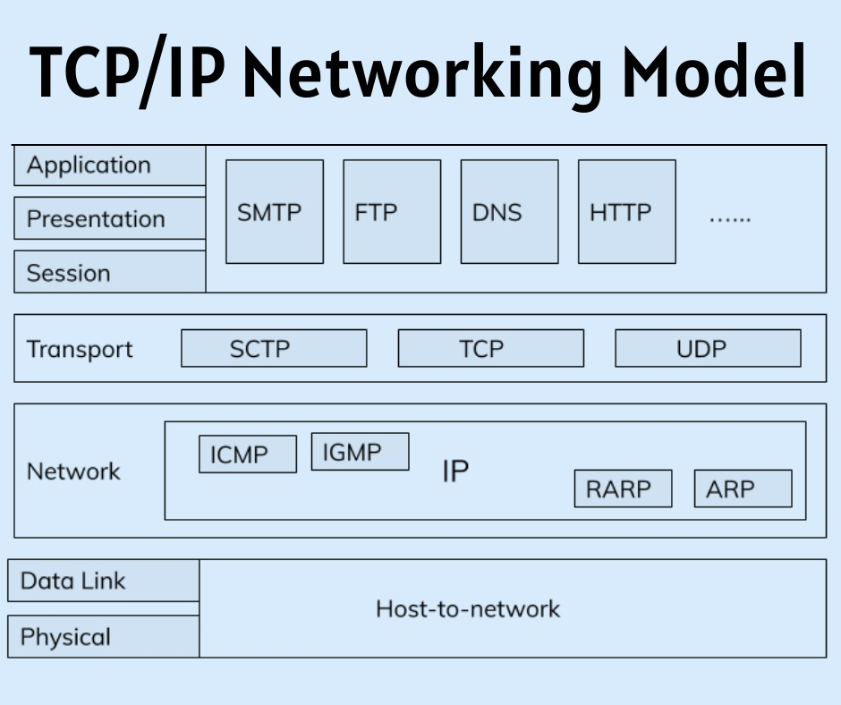
Introduction to the TCP/IP Model
Overview of the TCP/IP Model
The TCP/IP model is a concise framework for understanding networking protocols and architecture, consisting of four layers that correspond to the OSI model's seven layers.
Historical Background
Developed in the 1970s, TCP/IP was designed to facilitate communication over the Internet. It has become the dominant protocol suite due to its robustness and flexibility.
Essential in Modern Networking
The TCP/IP model is essential for modern networking, enabling devices to communicate over the Internet and supporting a wide range of applications and services.
Comparison to the OSI Model
While the OSI model provides a detailed framework, the TCP/IP model is more streamlined, focusing on the practical implementation of protocols in real-world scenarios.
Layers of the TCP/IP Model
The TCP/IP model consists of four layers: Link Layer: Corresponds to the OSI's Physical and Data Link layers. Internet Layer: Corresponds to the OSI's Network layer. Transport Layer: Corresponds to the OSI's Transport layer. Application Layer: Corresponds to the OSI's Session, Presentation, and Application layers.
Summary
The TCP/IP model is a crucial framework for understanding modern networking, providing a simplified approach to the complex world of data communication.

Slide 7
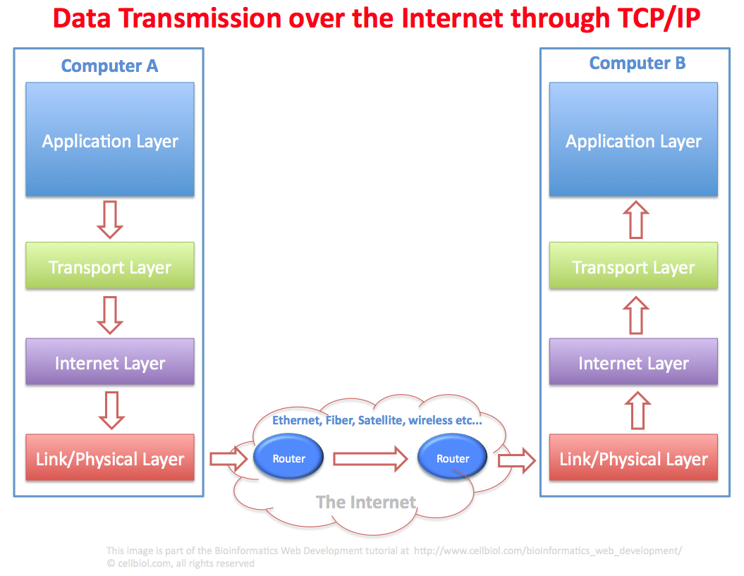
Practical Implementation of TCP/IP
Everyday Use of TCP/IP
TCP/IP is the backbone of the Internet, enabling a wide range of applications and services that we use daily.
Web Browsing
When you access a website, your browser uses HTTP over TCP/IP to request web pages from servers, facilitating the exchange of information.
Email Communication
Email protocols like SMTP and POP3 operate over TCP/IP, allowing users to send and receive messages seamlessly.
File Transfers
Protocols like FTP and SFTP enable file transfers over TCP/IP, allowing users to upload and download files from servers.
Streaming Services
Streaming platforms utilize TCP/IP to deliver audio and video content, ensuring smooth playback and minimal buffering.
Summary
TCP/IP is integral to daily Internet operations, enabling various applications and services that enhance our online experiences.

Slide 8
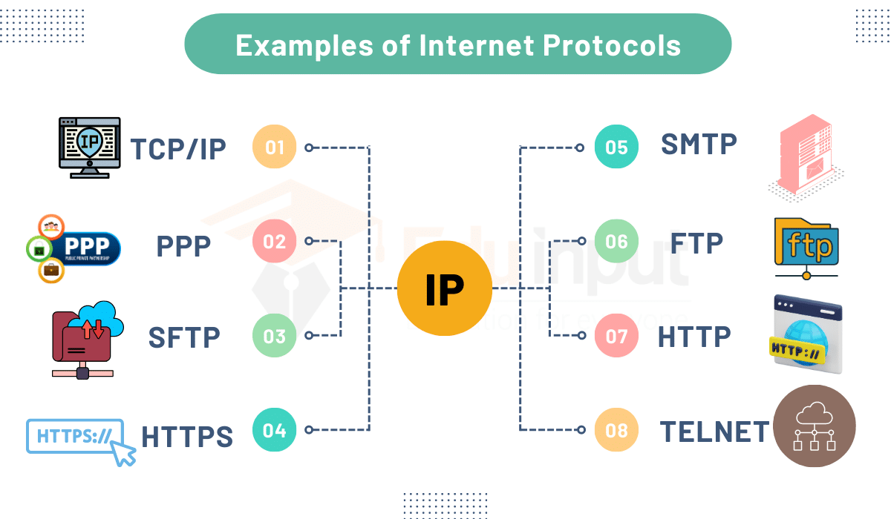
Importance of Protocols in Networking
Standardization of Communication
Protocols standardize communication processes across different systems, ensuring devices can connect and exchange data effectively.
Ensuring Compatibility
Protocols ensure that devices from different manufacturers can communicate seamlessly, promoting interoperability in networking.
Facilitating Data Exchange
Protocols define how data is formatted, transmitted, and received, enabling smooth data exchange between devices and applications.
Enhancing Security
Many protocols include security features, such as encryption and authentication, ensuring secure communication over networks.
Summary
Protocols are essential for effective networking, providing the standards and rules that enable devices to communicate, ensuring compatibility, and enhancing security.

Slide 9

Comparing TCP and UDP
Feature | TCP | UDP
This slide contains additional content. Please find it under the speaker notes below.
💡 SlidesAI Tip
Notes:
Comparison Table:

Slide 10
--|
Enter text

Slide 11
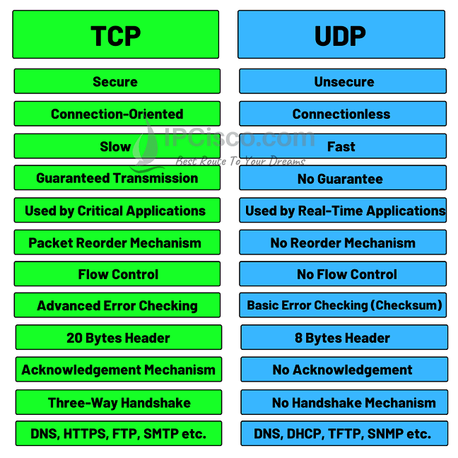
-| | Connection Type | Connection-oriented | Connectionless | | Reliability | Reliable delivery | Unreliable delivery | | Error Checking | Yes | No | | Speed | Slower | Faster | | Use Cases | Web browsing, email | Streaming, gaming |
### Summary of Differences
TCP is ideal for applications requiring reliable data transmission, while UDP is better suited for applications prioritizing speed and low latency.
### Real-World Examples
**TCP**: Downloading a file or sending an email.
**UDP**: Watching a live sports event or playing an online game.
### Importance of Choosing the Right Protocol
Selecting the appropriate protocol based on application requirements is crucial for optimizing performance and ensuring effective communication.

Slide 12
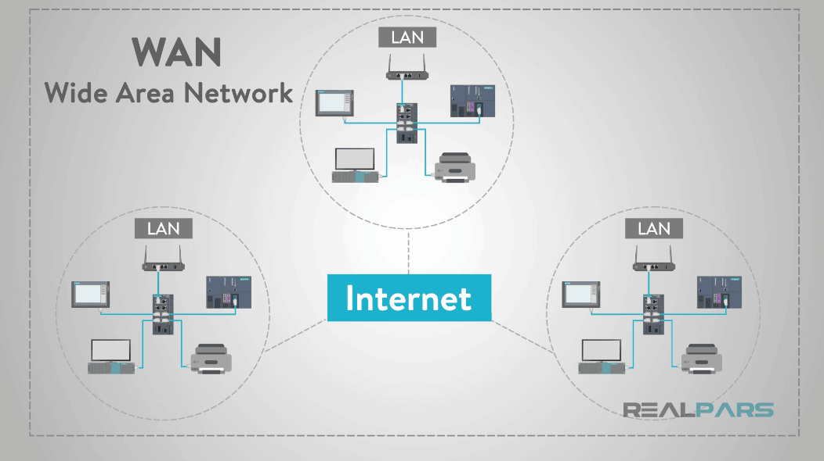
Introduction to Ethernet
### Explanation of Ethernet Technology
Ethernet is a widely used networking technology that facilitates communication over wired connections in local area networks (LANs). It defines standards for data transmission.
### Significance in Local Area Networks
Ethernet has become the dominant technology for LANs due to its reliability, speed, and simplicity, enabling devices to connect and communicate effectively.
### How Ethernet Works
Ethernet uses a system of frames to encapsulate data for transmission. Each frame contains source and destination MAC addresses, ensuring that data reaches the correct device.
### Media Access Control
Ethernet employs a media access control (MAC) protocol to manage how devices share the network medium, preventing collisions and ensuring orderly communication.
### Real-World Example
In an office environment, Ethernet cables connect computers, printers, and servers, allowing for seamless data transfer and resource sharing.
### Summary
Ethernet technology is fundamental to local area networking, providing a reliable and efficient means of communication over wired connections.

Slide 13

Troubleshooting Ethernet Connections
### Basic Troubleshooting Techniques
Common Ethernet connection issues can arise due to various factors, including cable faults, device misconfigurations, and network congestion.
### Potential Problems
**Cable Issues**: Damaged or improperly connected cables can disrupt connectivity.
**Device Configuration**: Incorrect network settings can prevent devices from communicating.
**Network Congestion**: High traffic levels can lead to slow performance or dropped connections.
### Solutions for Common Issues
**Check Cables**: Inspect and replace damaged cables to restore connectivity.
**Verify Settings**: Ensure devices are configured correctly with the appropriate IP addresses and subnet masks.
**Monitor Traffic**: Use network monitoring tools to identify and address congestion issues.
### Illustrations of Troubleshooting Steps
Visual aids can enhance understanding of troubleshooting techniques and common problems encountered in Ethernet connections.
### Summary
Basic troubleshooting techniques are essential for maintaining Ethernet connections, ensuring reliable communication and optimal network performance.

Slide 14
Wireless Standards and Protocols
### Introduction to Wireless Standards
Wireless communication standards define the specifications for data transmission over wireless networks, ensuring compatibility and interoperability among devices.
### IEEE 802.11 Standards
The IEEE 802.11 family of standards governs WLANs, with various versions offering different speeds and features:
**802.11a**: 54 Mbps over 5 GHz frequency.
**802.11b**: 11 Mbps over 2.4 GHz frequency.
**802.11g**: 54 Mbps over 2.4 GHz frequency.
**802.11n**: Up to 600 Mbps using multiple antennas.
**802.11ac**: Gigabit speeds over 5 GHz frequency.
### Summary of Applications and Differences
Different wireless standards are used based on requirements for speed, range, and interference resistance, making it essential to choose the appropriate standard for specific applications.
### Visuals for Standards
Diagrams comparing the various IEEE 802.11 standards can help illustrate their differences and applications in real-world scenarios.
This slide contains additional content. Please find it under the speaker notes below.
💡 SlidesAI Tip
Notes:
### Introduction to Wireless Standards
Wireless communication standards define the specifications for data transmission over wireless networks, ensuring compatibility and interoperability among devices.
### IEEE 802.11 Standards
The IEEE 802.11 family of standards governs WLANs, with various versions offering different speeds and features:
**802.11a**: 54 Mbps over 5 GHz frequency.
**802.11b**: 11 Mbps over 2.4 GHz frequency.
**802.11g**: 54 Mbps over 2.4 GHz frequency.
**802.11n**: Up to 600 Mbps using multiple antennas.
**802.11ac**: Gigabit speeds over 5 GHz frequency.
### Summary of Applications and Differences
Different wireless standards are used based on requirements for speed, range, and interference resistance, making it essential to choose the appropriate standard for specific applications.
### Visuals for Standards
Diagrams comparing the various IEEE 802.11 standards can help illustrate their differences and applications in real-world scenarios.

Slide 15
Comparison Between UTP and STP
Feature | UTP | STP
This slide contains additional content. Please find it under the speaker notes below.
💡 SlidesAI Tip
Notes:
Comparison Table:

Slide 16
--|
Enter text

Slide 17
|
Enter text

Slide 18
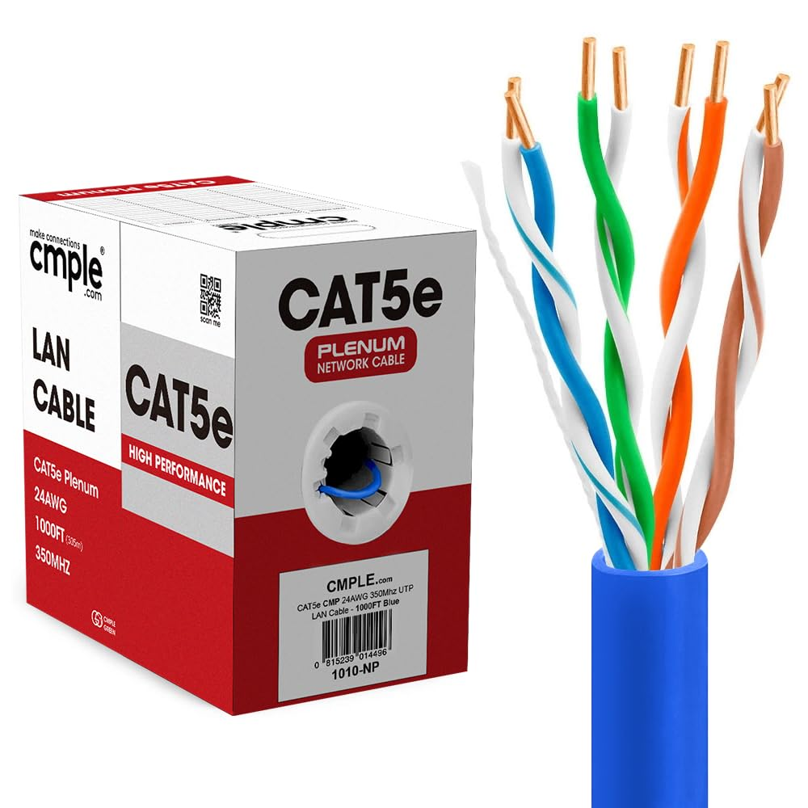
Practical Applications of Each Category
### Real-World Examples of Cable Usage
**CAT5e**: Used in small office networks for standard internet connectivity.
**CAT6**: Commonly used in enterprise environments where high-speed connections are required.
**CAT6a**: Ideal for data centers needing high-speed connections over longer distances.
**CAT7**: Used in environments with high interference, ensuring reliable performance.
**CAT8**: Employed in data centers for high-speed connections between servers and switches.
### Summary
Selecting the appropriate cable category based on real-world applications is crucial for optimizing network performance and reliability.

Slide 19
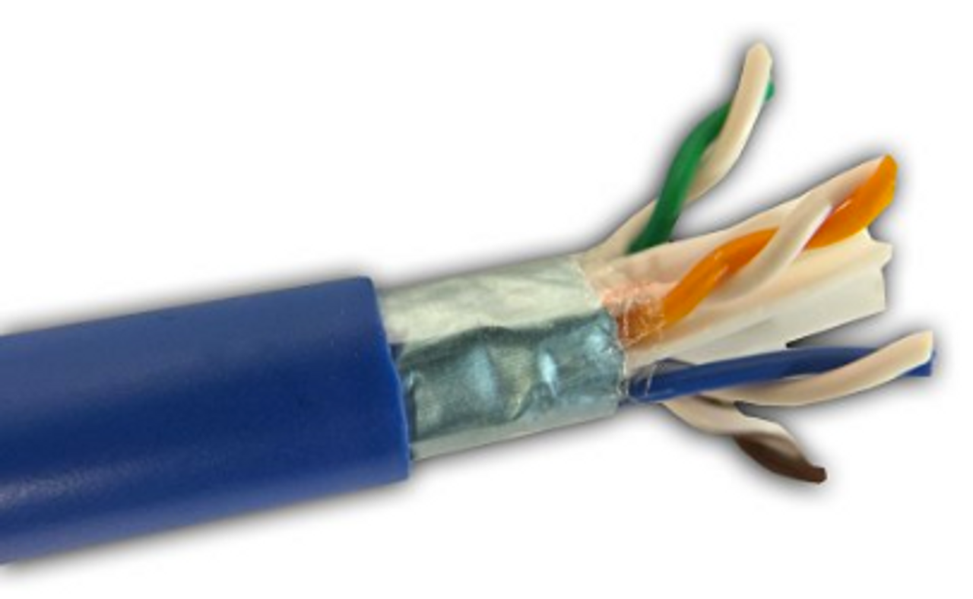
Real-World Applications of CAT5e
### Examples of CAT5e Deployment
**Residential Networks**: Used in homes to connect computers, smart TVs, and gaming consoles to the internet.
**Small Office Networks**: Employed in small businesses for reliable connectivity among devices, such as computers and printers.
**Educational Institutions**: Used in schools and universities to connect classrooms and labs to the internet.
### Summary
CAT5e cables are widely used in various real-world applications, providing reliable connectivity for both residential and commercial environments.

Slide 20
The Evolution of Networking
The development of **ARPANET**, one of the first **networks**, marks the beginning of networking, allowing computers to connect within a limited geographical area.
1960s
The rise of **Ethernet** technology enhances **Local Area Networks (LANs)**, enabling resource sharing like printers and files among nearby computers.
1980s
The introduction of the **Internet Protocol Suite (TCP/IP)** standardizes networking, facilitating the expansion of **Wide Area Networks (WANs)** and global connectivity.
1990s
**Wireless networking technologies (Wi-Fi)** revolutionize access, allowing devices to connect without physical cables, making networking more accessible.
2000s

Slide 21
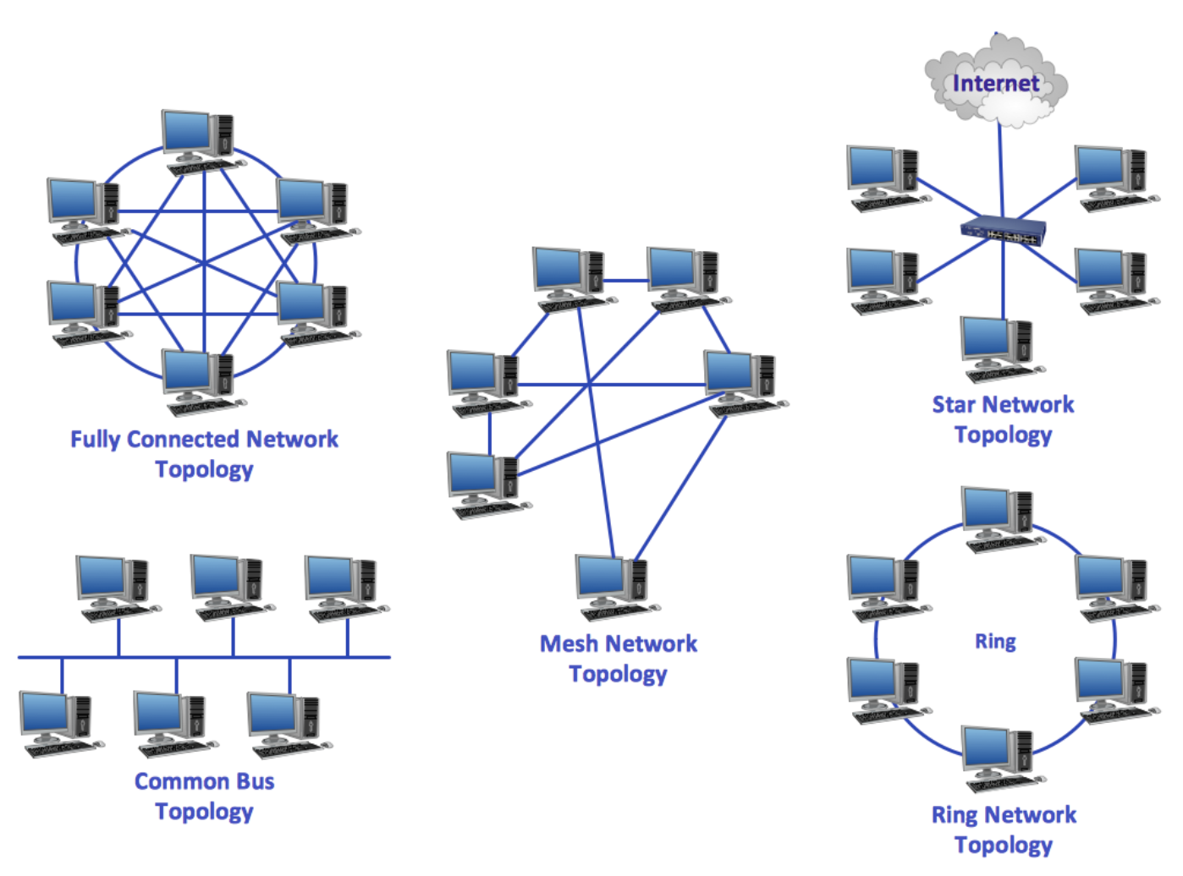
Types of Networks
Understanding the different types of networks is essential for grasping how they function and their applications in various settings.
**Local Area Network (LAN)**: A LAN connects computers within a limited area, such as a home, office, or campus. It allows for high-speed data transfer and resource sharing among connected devices.
**Metropolitan Area Network (MAN)**: A MAN covers a larger geographic area than a LAN, typically spanning a city or a large campus. It connects multiple LANs and facilitates communication across a broader region.
**Wide Area Network (WAN)**: WANs connect multiple LANs over long distances, often using leased telecommunication lines. The Internet is the largest example of a WAN, enabling global connectivity.
**Personal Area Network (PAN)**: A PAN is a small network, typically within a range of a few meters, connecting personal devices like smartphones, tablets, and laptops via Bluetooth or Wi-Fi.
**Real-World Examples**: An office network where employees share files and printers; A city's public Wi-Fi network providing internet access in parks and public spaces; A multinational corporation's network connecting offices in different countries.

Slide 22
Internetworking Devices
Overview of Key Devices
Device Functions
Visuals and Summary
Internetworking devices play a crucial role in facilitating communication between different networks. Key devices include **routers**, **switches**, **bridges**, and **hubs**.
**Routers** connect multiple networks and direct data packets to their destinations using routing tables. **Switches** connect devices within a single network, managing data traffic and reducing collisions. **Bridges** connect two or more network segments, filtering traffic and reducing collisions. **Hubs** connect multiple Ethernet devices, transmitting data to all connected devices.
Diagrams illustrating how **routers**, **switches**, **bridges**, and **hubs** function within a network can enhance comprehension. Internetworking devices are essential for ensuring efficient communication and data exchange between networks.

Slide 23
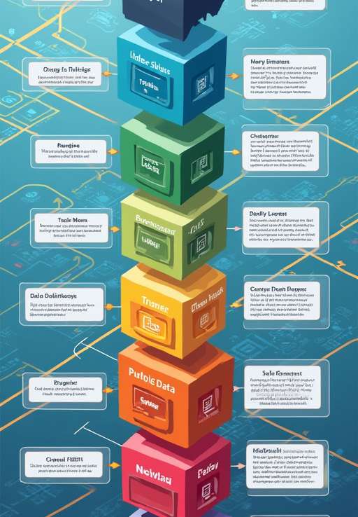
Visualization of the OSI Model
Visualizing the OSI model enhances comprehension of how data is transmitted and processed across different layers, emphasizing the importance of each layer's function.
**Diagram of the OSI Model**: A visual representation of the OSI model can illustrate the seven layers and their functions, making it easier to understand how data flows through a network.
**Layer Descriptions**: Each layer can be described alongside the diagram, highlighting its role and the protocols associated with it, such as:
**Physical Layer**: Ethernet; **Data Link Layer**: PPP; **Network Layer**: IP; **Transport Layer**: TCP, UDP; **Session Layer**: NetBIOS; **Presentation Layer**: SSL; **Application Layer**: HTTP, FTP.
**Examples of Protocols**: Providing examples of common protocols associated with each layer can help solidify understanding of the OSI model's practical applications.

Slide 24
Importance of the OSI Model
The OSI model is essential for understanding networking, troubleshooting issues, and promoting interoperability among diverse technologies.
**Framework for Understanding Networking**: The OSI model provides a structured framework for understanding networking concepts, allowing for better communication and collaboration among network professionals.
**Troubleshooting Communication Issues**: By isolating problems to specific layers, the OSI model simplifies troubleshooting. For example, if a network issue arises, technicians can identify whether it is a physical, data link, or application layer problem.
**Standardization of Protocols**: The OSI model promotes the standardization of protocols, ensuring that different devices and systems can communicate effectively, regardless of their underlying technologies.
**Enhancing Interoperability**: The model facilitates interoperability between different systems, enabling diverse technologies to work together seamlessly. This is crucial in an increasingly interconnected world.
**Real-World Applications**: Network engineers and IT professionals use the OSI model as a reference point for designing, implementing, and managing networks, ensuring efficient communication and data exchange.

Slide 25
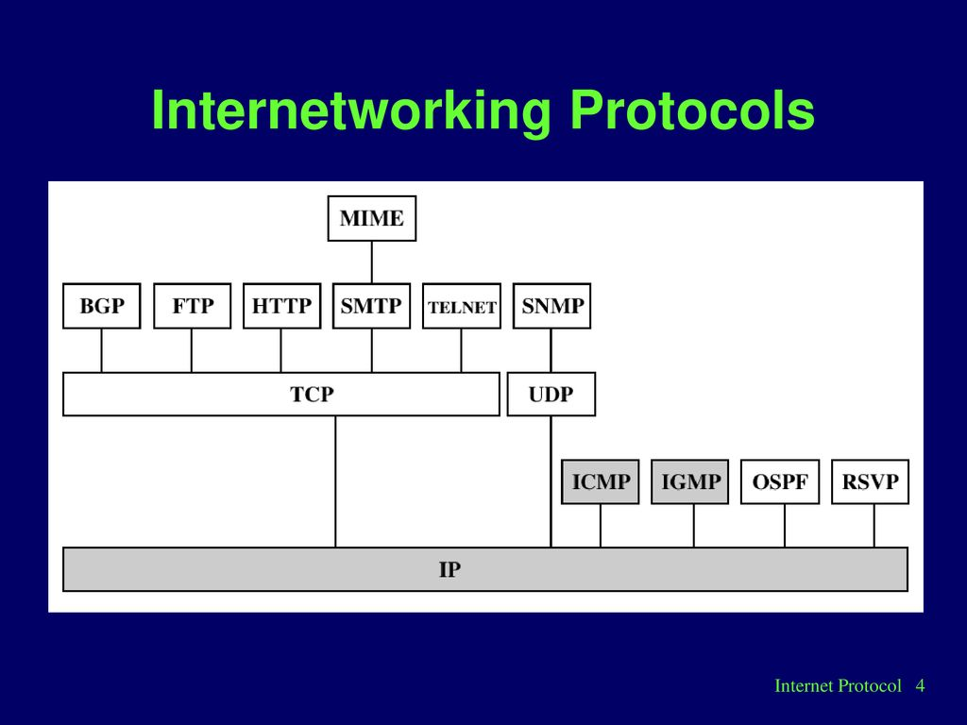
Common Internetworking Protocols
Introduction to Common Protocols: Internetworking protocols are essential for facilitating communication between devices on different networks. They define rules and conventions for data exchange.
**TCP/IP** (Transmission Control Protocol/Internet Protocol): TCP/IP is the foundational protocol suite for the Internet. It breaks data into packets for transmission and ensures reliable delivery through error checking and retransmission.
**HTTP** (Hypertext Transfer Protocol): HTTP is the protocol used for transmitting web pages. It enables communication between web browsers and servers, allowing users to access and interact with online content.
**FTP** (File Transfer Protocol): FTP is used for transferring files between computers over a network. It allows users to upload and download files securely.
**SMTP** (Simple Mail Transfer Protocol): Used for sending emails.
**DNS** (Domain Name System): Translates domain names into IP addresses.

Slide 26
Layers of the TCP/IP Model
Link Layer
Internet Layer
Transport and Application Layers
The **Link layer** is responsible for the physical connection between devices and the data transfer over a specific medium, including protocols like **Ethernet** and **Wi-Fi**.
The **Internet layer** manages the routing of data packets across networks using the **Internet Protocol (IP)** to address and route packets.
The **Transport layer** ensures reliable data transfer between hosts with protocols like **TCP** and **UDP**. The **Application layer** interfaces directly with end-user applications, including protocols like **HTTP**, **FTP**, and **DNS**.

Slide 27
Comparison of OSI and TCP/IP
Overview of OSI vs. TCP/IP
Strengths and Weaknesses
The **OSI model** and **TCP/IP model** are both frameworks for understanding networking, but they differ in structure and application.
The **OSI model** offers a **detailed framework** and a **layered approach**, while the **TCP/IP model** is known for its **simplicity** and **widespread adoption**. However, the OSI model can be **complex** and less adopted, whereas the TCP/IP model lacks **detailed structure**.

Slide 28
Understanding Internet Protocols
Definition and Role
Categorization of Protocols
Key Protocols
**Internet protocols** are standardized rules that govern how data is transmitted over the Internet, ensuring devices can communicate effectively.
Internet protocols can be categorized into several types: **Network Protocols** (e.g., **IP**), **Transport Protocols** (e.g., **TCP**, **UDP**), and **Application Protocols** (e.g., **HTTP**, **FTP**).
Key protocols include **IP** for addressing and routing packets, **TCP** for reliable data delivery, and **UDP** for fast, connectionless communication.

Slide 29
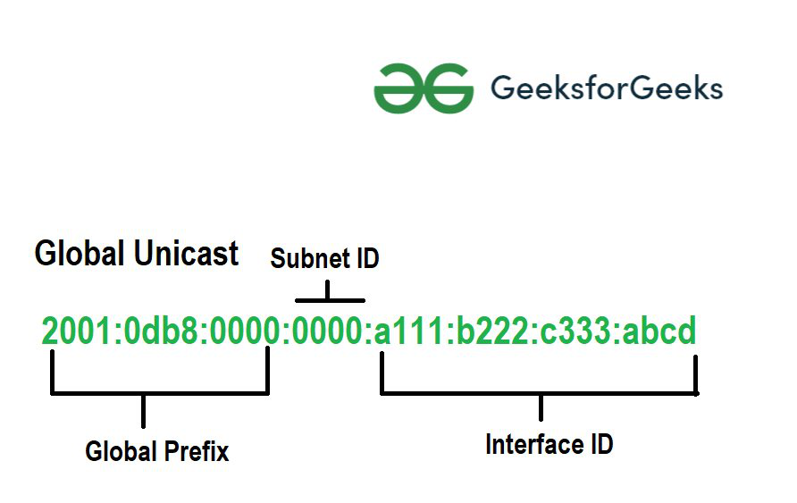
IPv4 vs. IPv6
Overview of IPv4 and Limitations
Introduction to IPv6 and Improvements
IPv4 (Internet Protocol version 4) is the most widely used addressing scheme, utilizing **32-bit addresses**. However, it faces **address exhaustion** due to the rapid growth of the Internet.
IPv6 (Internet Protocol version 6) addresses IPv4's limitations with **128-bit addresses**, allowing for an almost unlimited number of unique addresses. It offers a **larger address space**, **simplified addressing**, and **enhanced security** features.

Slide 30
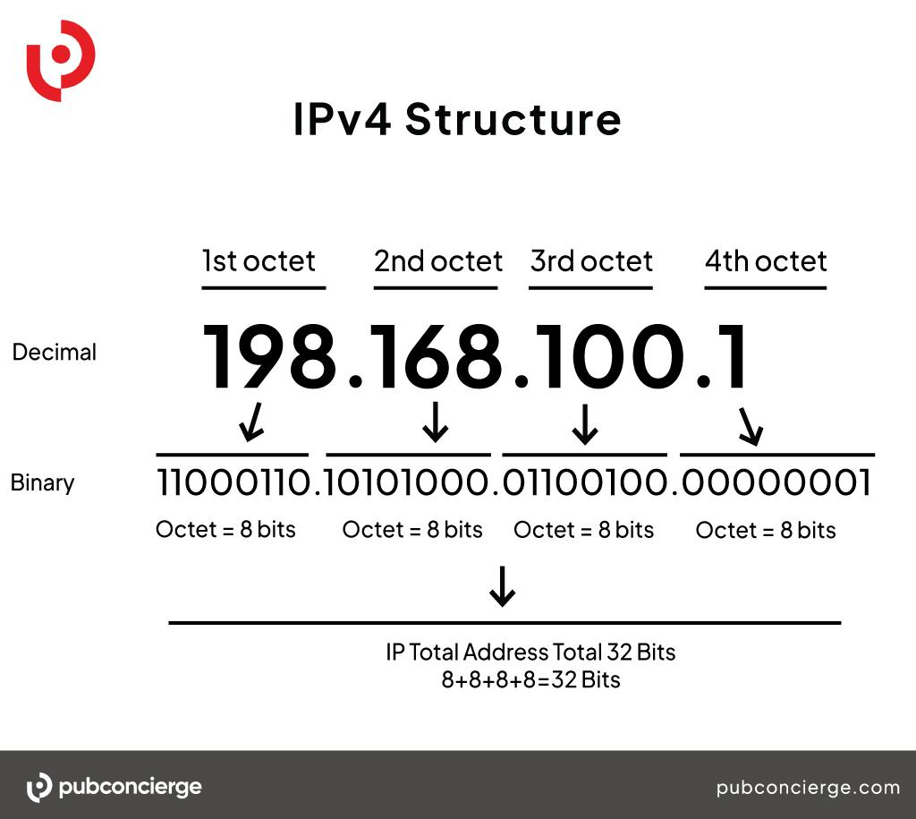
Role of Subnetting
Definition of Subnetting: Subnetting is the practice of dividing a larger network into smaller, more manageable subnetworks (subnets). It enhances network performance and security.
**Efficient IP Address Management**: Subnetting allows for better utilization of IP addresses, reducing wastage.
**Improved Network Performance**: Smaller subnets reduce network congestion and improve data transmission speeds.
**Enhanced Security**: Subnets can be isolated from each other, limiting access and improving security.

Slide 31
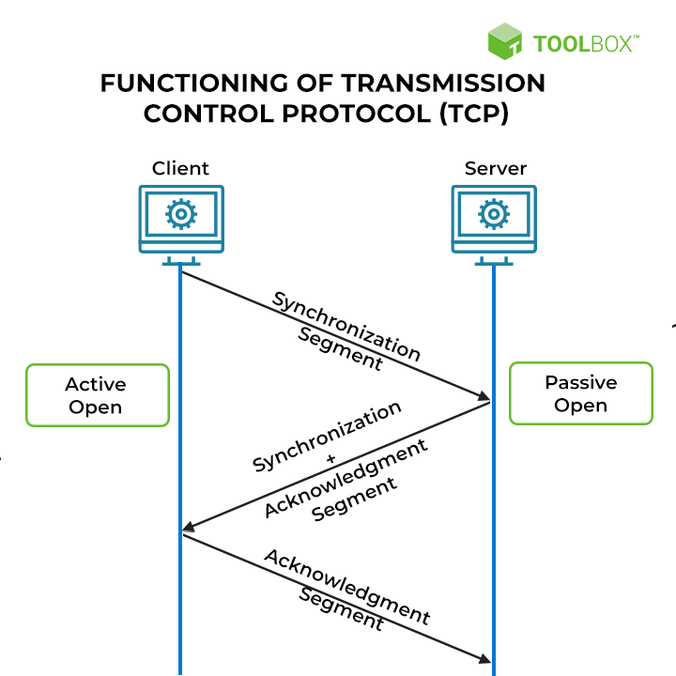
TCP vs. UDP: Which to Use
Definition of TCP: TCP (Transmission Control Protocol) is a connection-oriented protocol that ensures reliable data transmission through error checking and retransmission.
**Reliability**: TCP guarantees that data is delivered accurately and in order.
**Connection-Oriented**: A connection must be established before data transfer.
**Error Checking**: TCP includes mechanisms for detecting and correcting errors.
**Speed**: UDP is faster than TCP due to its connectionless nature.
**Low Latency**: Ideal for applications where speed is critical, such as streaming.

Slide 32

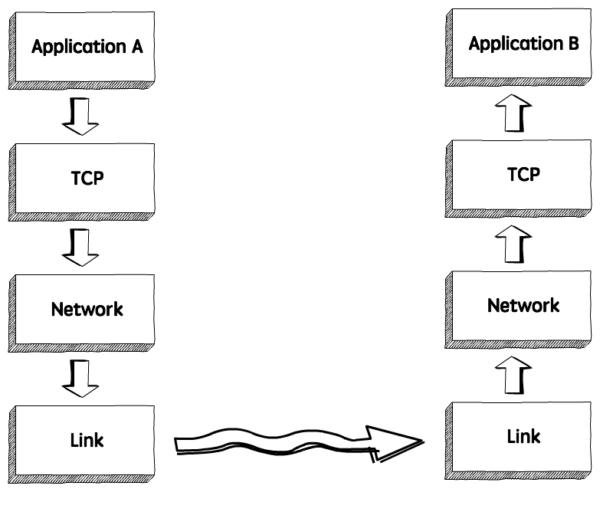
TCP Characteristics
Connection-Oriented Communication
Error Checking and Data Reliability
Flow Control and Real-World Example
**TCP** establishes a **connection** between sender and receiver before transmitting data, ensuring that both parties are ready to communicate.
**TCP** includes **error-checking mechanisms** to detect and correct data transmission errors, ensuring accurate delivery of information. It guarantees that all data packets are received in the correct order, retransmitting any lost packets.
**TCP** uses **flow control mechanisms** to manage the rate of data transmission, preventing network congestion. For example, when you download a file from the Internet, **TCP** ensures that the entire file is received accurately and in the correct order.

Slide 33
UDP Characteristics
Connectionless Communication and Low Latency
Simplicity and No Error Checking
Use Cases and Summary
**UDP** does not establish a **connection** before transmitting data, allowing for faster data transfer without the overhead of connection setup. This results in **lower latency**, making it ideal for real-time applications.
**UDP** is simpler than **TCP**, with fewer features and overhead, allowing for faster data transmission. However, it does not guarantee the delivery of packets or their order, making it less reliable.
**UDP** is commonly used for **streaming** and **online gaming**, where speed is prioritized over reliability. Its connectionless nature and simplicity make it suitable for applications requiring quick communication.

Slide 34

How Ethernet Works
Overview of Ethernet Operation: Ethernet operates by transmitting data in frames over a physical medium, such as twisted-pair cables or fiber optics. Each frame contains essential information for data delivery.
**Frame Creation**: Data is encapsulated into frames, including source and destination MAC addresses.
**Collision Detection**: Ethernet uses a Carrier Sense Multiple Access with Collision Detection (CSMA/CD) protocol to manage access to the network.
**Data Transmission**: Frames are transmitted over the network medium to the intended recipient.

Slide 35
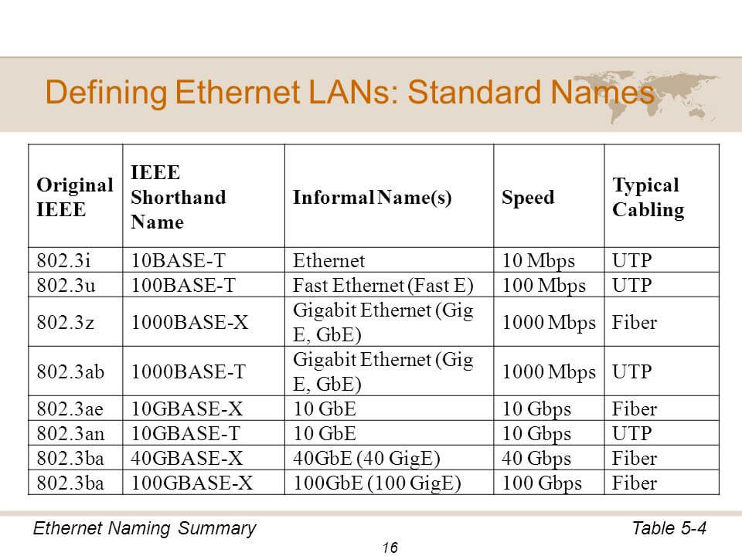
Ethernet Standards
Overview of Ethernet Standards: Ethernet standards define the specifications for data transmission speeds, cable types, and network configurations. They ensure compatibility and interoperability among devices.
**10BASE-T**: Supports speeds of 10 Mbps over twisted-pair cables.
**100BASE-TX**: Supports speeds of 100 Mbps over twisted-pair cables.
**1000BASE-T**: Supports speeds of 1 Gbps over twisted-pair cables.

Slide 36
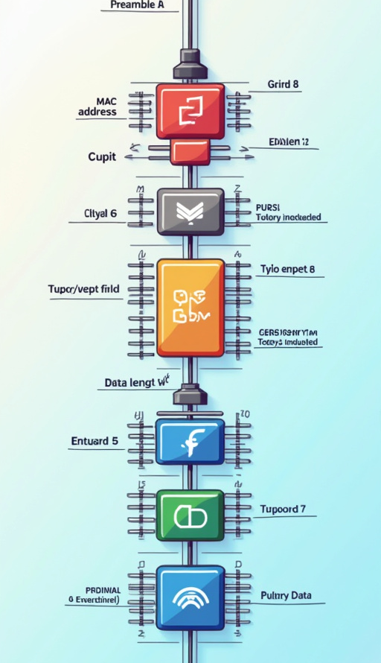
Ethernet Frame Structure
Elements of Ethernet Frame Structure: An Ethernet frame consists of several key elements that facilitate data transmission:
**Preamble**: A series of bits used for synchronization.
**MAC Addresses**: Source and destination addresses for identifying devices.
**Type/Length Field**: Indicates the type of data contained in the frame or its length.
**Data Payload**: The actual data being transmitted.
**Frame Check Sequence (FCS)**: A checksum used for error detection.

Slide 37
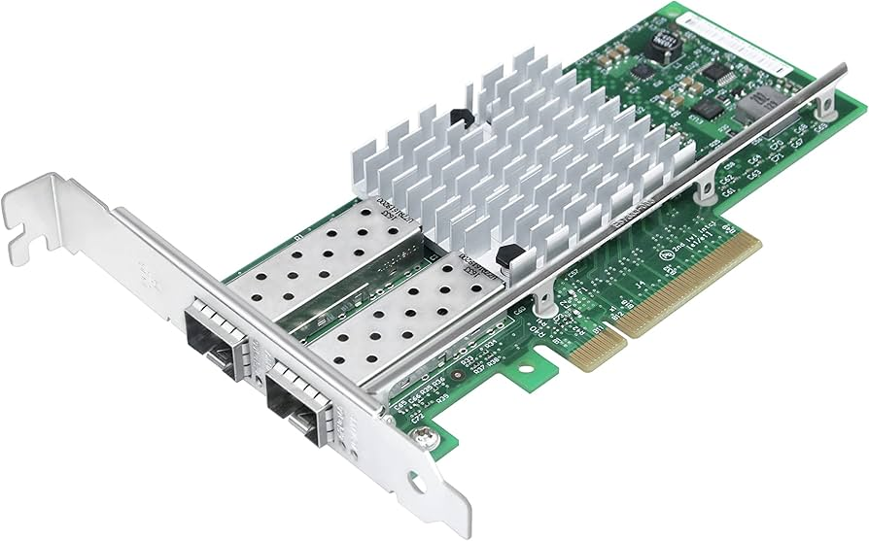
Advanced Ethernet Technologies
Overview of Advanced Ethernet Technologies: Advanced Ethernet technologies enhance network management and performance, providing additional features and capabilities beyond standard Ethernet.
**Virtual Local Area Networks (VLANs)**: VLANs allow network administrators to segment networks logically, improving security and performance by isolating traffic within specific groups.
**Quality of Service (QoS)**: QoS mechanisms prioritize certain types of traffic, ensuring that critical applications receive the necessary bandwidth and minimizing latency.
**Ethernet over Fiber**: Ethernet over fiber technology enables high-speed data transmission over longer distances, making it suitable for enterprise and data center applications.
**Summary**: Advanced Ethernet technologies provide enhanced capabilities for network management, security, and performance, making them essential for modern networking environments.
**Real-World Applications**: Organizations use advanced Ethernet technologies to optimize their networks, improve security, and ensure reliable communication across diverse applications.

Slide 38
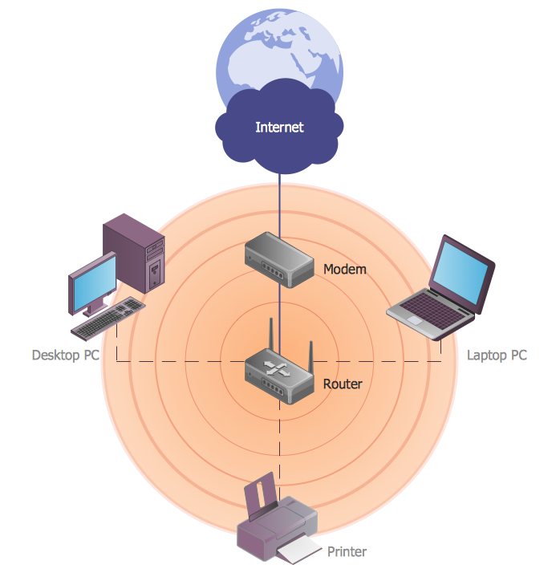
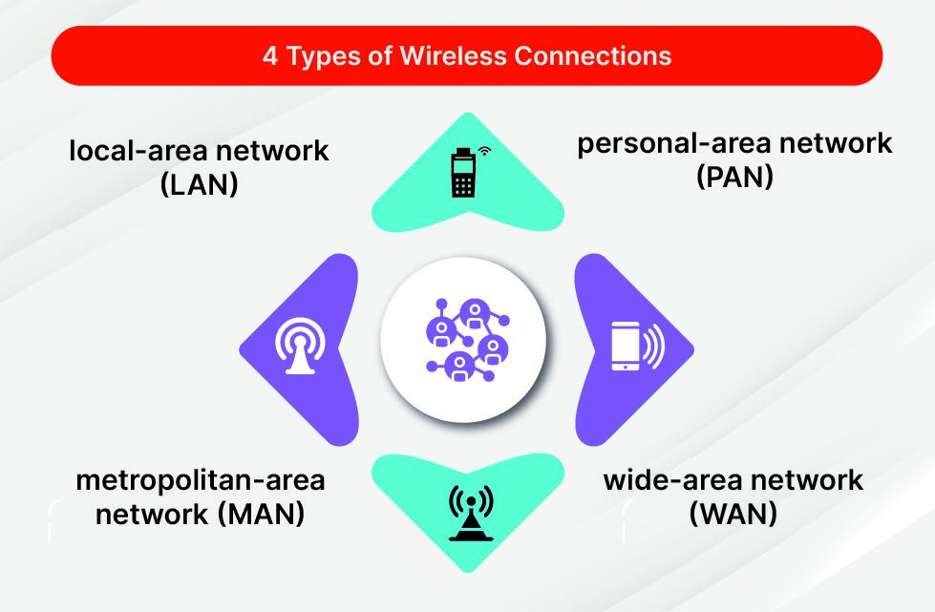

Wireless Networking Explained
Basics of Wireless Networking
Significance and Technologies
Real-World Example and Summary
**Wireless networking** allows devices to connect and communicate without physical cables, using **radio waves** or **infrared signals** to transmit data.
**Wireless technology** has revolutionized communication, enabling mobility and flexibility. Key technologies include **Wi-Fi**, **Bluetooth**, and **cellular networks**, each serving different purposes.
In a coffee shop, customers can connect to the **Wi-Fi network** using their devices, enjoying internet access without cables. **Wireless networking** is fundamental to modern communication, providing convenience and accessibility.

Slide 39
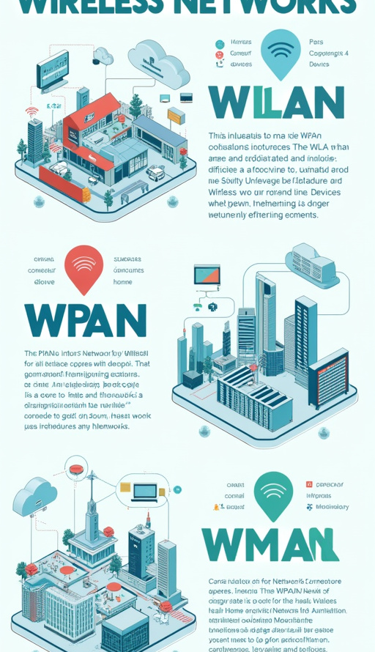
Types of Wireless Networks
Overview of Wireless Network Types: Wireless networks can be categorized into several types based on their coverage area and application:
**Wireless Local Area Network (WLAN)**: WLANs connect devices within a limited area, such as homes or offices, using Wi-Fi technology to provide internet access.
**Wireless Personal Area Network (WPAN)**: WPANs connect personal devices over short distances using technologies like Bluetooth, enabling communication between smartphones, tablets, and wearables.
**Wireless Metropolitan Area Network (WMAN)**: WMANs cover larger geographic areas, such as cities, providing wireless connectivity to multiple users and devices.
**Real-World Examples**:
- **WLAN**: A home Wi-Fi network connecting laptops, smartphones, and smart devices.
- **WPAN**: A Bluetooth connection between a smartphone and wireless headphones.
- **WMAN**: A city's public Wi-Fi network providing internet access in parks and public spaces.
Visual Examples: Diagrams showcasing the different types of wireless networks can enhance comprehension of their coverage areas and applications.
**Summary**: Understanding the various types of wireless networks is essential for grasping their applications and how they facilitate communication in different contexts.

Slide 40
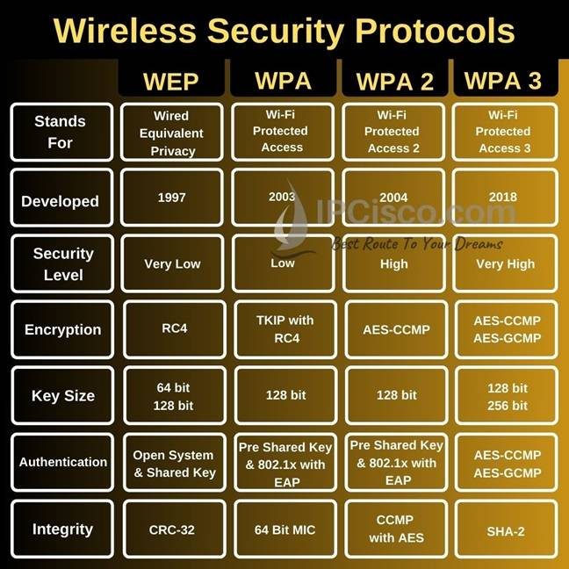
Security in Wireless Networking
Overview of Wireless Security Protocols: Wireless networking poses unique security challenges, making it essential to implement robust security protocols to protect data transmission.
**Common Security Protocols**:
- **WPA2 (Wi-Fi Protected Access 2)**: Provides strong encryption and authentication for wireless networks.
- **WPA3**: The latest security protocol, offering enhanced protection against brute-force attacks and improved encryption.
**Importance of Security Protocols**: Implementing security protocols is crucial for safeguarding sensitive data transmitted over wireless networks, preventing unauthorized access and data breaches.
**Real-World Example**: A business uses WPA2 to secure its Wi-Fi network, ensuring that only authorized employees can access sensitive information and resources.
**Summary**: Wireless security protocols are essential for protecting data and maintaining the integrity of wireless networks in various environments.

Slide 41
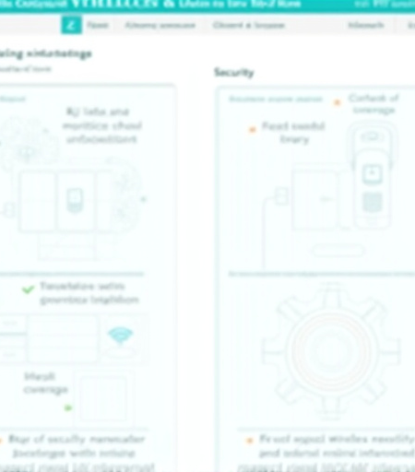
Challenges in Wireless Networking
Overview of Wireless Networking Challenges
Solutions to Challenges
Wireless networking presents unique challenges that can impact **performance**, **security**, and **reliability**.
To address these challenges, it is essential to **minimize interference**, **enhance coverage**, and **implement security measures** to protect data.

Slide 42
Understanding UTP and STP
Definitions
Differences
Applications
- **Unshielded Twisted Pair (UTP)**: A type of networking cable that consists of pairs of wires twisted together, commonly used in **Ethernet networks**.
- **Shielded Twisted Pair (STP)**: Similar to UTP, but with an additional shielding layer to reduce **electromagnetic interference (EMI)**.
- **Shielding**: UTP lacks shielding, while STP includes shielding to protect against interference.
- **Cost**: UTP is generally less expensive than STP due to its simpler construction.
- **Performance**: STP offers better performance in environments with high EMI, making it suitable for sensitive applications.
- **UTP**: Commonly used in home and office networks for **Ethernet connections**.
- **STP**: Used in environments with significant interference, such as **industrial settings** or **data centers**.

Slide 43
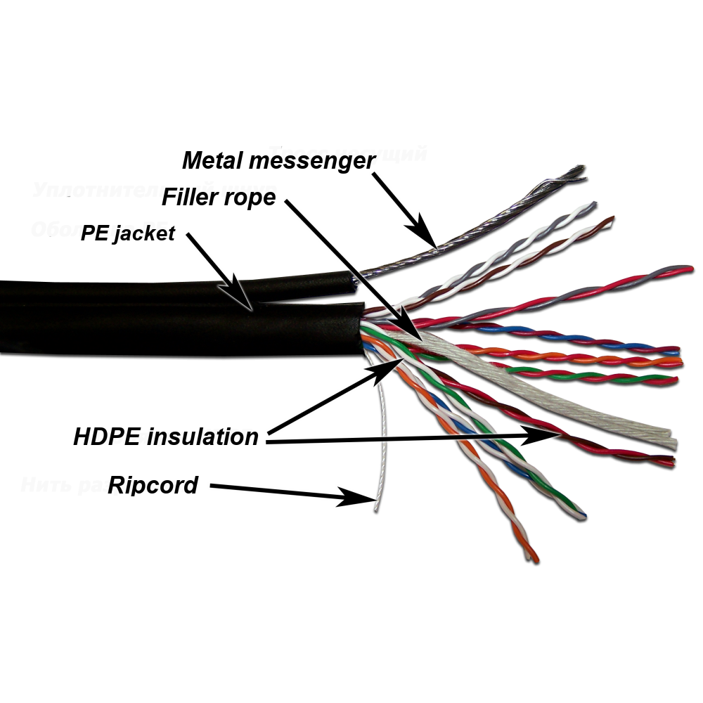
Summary of Differences: UTP is suitable for most applications, while STP is preferred in environments with high electromagnetic interference.
Shielding: No vs Yes
Cost: Lower vs Higher
Performance: Adequate for most uses vs Better in high EMI
Typical Uses: Home/office networks vs Industrial/data center
Visual Examples: Images of UTP and STP cables can help illustrate their differences and construction.

Slide 44
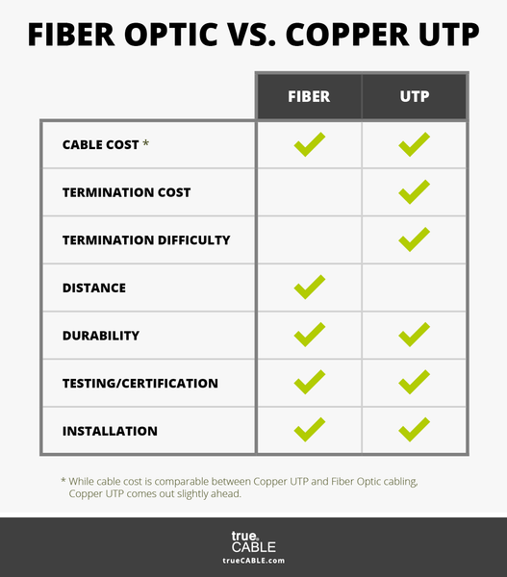
Advantages and Disadvantages
Advantages of UTP:
**Cost-Effective**: UTP cables are generally less expensive, making them ideal for budget-conscious installations.
**Ease of Installation**: UTP is lighter and easier to handle, simplifying installation processes.
**Limited Performance in Noisy Environments**: UTP may experience performance degradation in areas with high electromagnetic interference.
**Improved Performance**: STP provides better performance in environments with significant interference, ensuring reliable data transmission.
**Enhanced Security**: The shielding in STP cables can help prevent eavesdropping and unauthorized access.
**Higher Cost**: STP cables are more expensive than UTP, increasing overall installation costs.
**Bulkier**: STP cables are typically thicker and less flexible, making installation more challenging.
Summary: Both UTP and STP cables have their advantages and disadvantages, making it essential to choose the right type based on specific networking requirements.

Slide 45
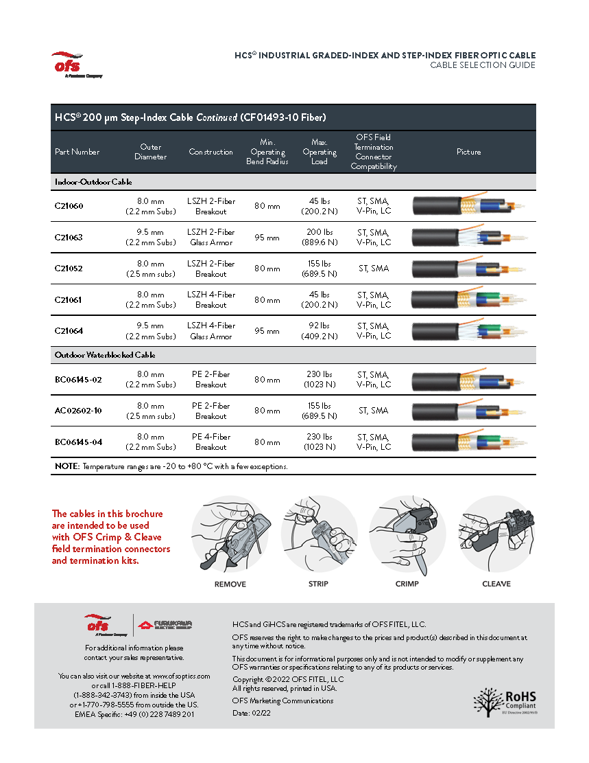
When to Use UTP or STP
Guidelines for Choosing Cable Type:
**Use UTP**: When cost is a primary concern and the environment is relatively free of electromagnetic interference.
**Use STP**: In environments with high EMI, such as industrial settings, where reliable performance is critical.
Environmental Considerations: Consider factors such as distance, potential interference sources, and data integrity requirements when selecting between UTP and STP.
Summary: Selecting the appropriate cable type based on environmental conditions and performance needs is crucial for ensuring optimal network performance.

Slide 46
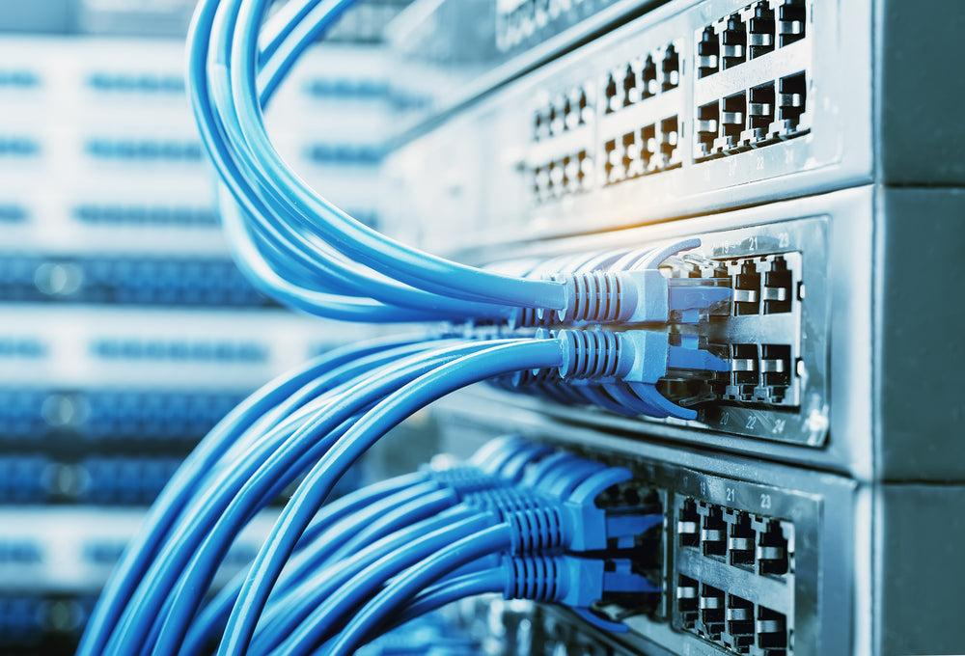
Introduction to Cable Categories
Overview of Networking Cable Categories: Networking cables are categorized based on their specifications, including transmission speeds, data integrity, and applications. Categories range from **CAT1** to **CAT8**.
**CAT1**: Used for voice communication; not suitable for data transmission.
**CAT5**: Supports speeds up to 100 Mbps; commonly used for Ethernet networks.
**CAT5e**: Enhanced version of CAT5, supporting speeds up to 1 Gbps with reduced crosstalk.
**CAT6**: Supports speeds up to 10 Gbps over short distances; suitable for high-performance networks.
**CAT6a**: Augmented version of CAT6, capable of 10 Gbps at longer distances.
**CAT7**: Supports speeds up to 10 Gbps with better shielding against interference.
**CAT8**: The latest standard, supporting speeds up to 25-40 Gbps for data centers.

Slide 47
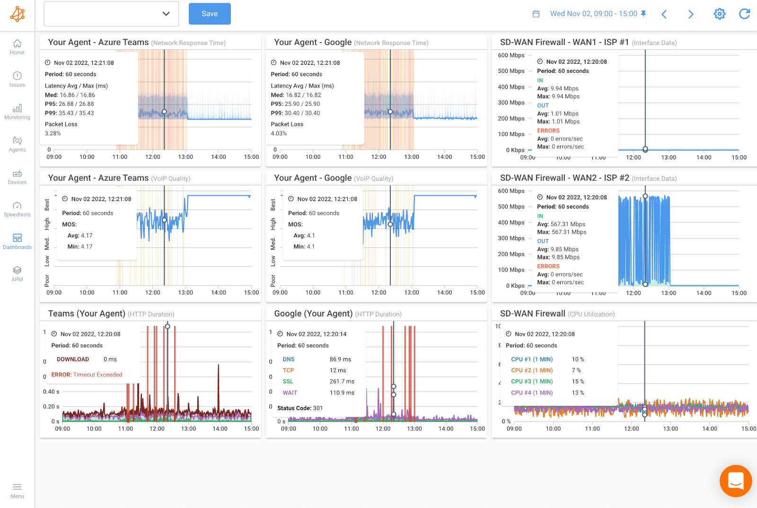
Detailed Look at Categories
In-Depth Examination of Cable Categories: Each cable category has specific performance metrics and applications, making it essential to choose the right category for specific networking needs.
**Transmission Speed**: Indicates the maximum speed at which data can be transmitted.
**Maximum Length**: Specifies the maximum distance a cable can run without signal degradation.
**CAT5e**: Up to 1 Gbps, maximum length of 100 meters.
**CAT6**: Up to 10 Gbps, maximum length of 55 meters for 10 Gbps.
**CAT6a**: Up to 10 Gbps, maximum length of 100 meters.
**CAT7**: Up to 10 Gbps, maximum length of 100 meters.
**CAT8**: Up to 25-40 Gbps, maximum length of 30 meters.

Slide 48
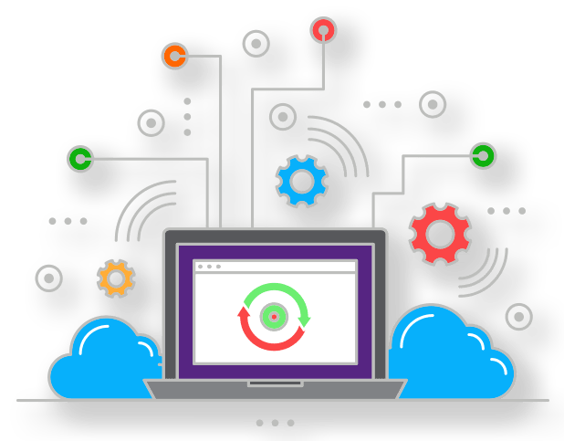
Importance of Choosing the Right Cable
Impact on Network Performance: The choice of networking cable significantly affects overall network performance, reliability, and data integrity.
Reliability Considerations: Using the right cable type minimizes the risk of signal degradation, interference, and data loss, ensuring smooth communication between devices.
Cost Implications: Selecting the appropriate cable can also impact installation costs. While higher-category cables may offer better performance, they also come at a higher price.

Slide 49
Understanding the "e" in CAT5e
Explanation of "Enhanced"
Features of CAT5e
Applications of CAT5e
The "e" in CAT5e stands for **"Enhanced,"** indicating improvements over the original **CAT5 standard**.
- **Reduced Crosstalk**: CAT5e cables are designed to minimize crosstalk, improving **data integrity** and **transmission speeds**.
- **Higher Data Rates**: CAT5e supports speeds of up to **1 Gbps**, making it suitable for modern networking needs.
CAT5e cables are commonly used in home and small office networks, providing reliable connectivity for various applications.

Slide 50
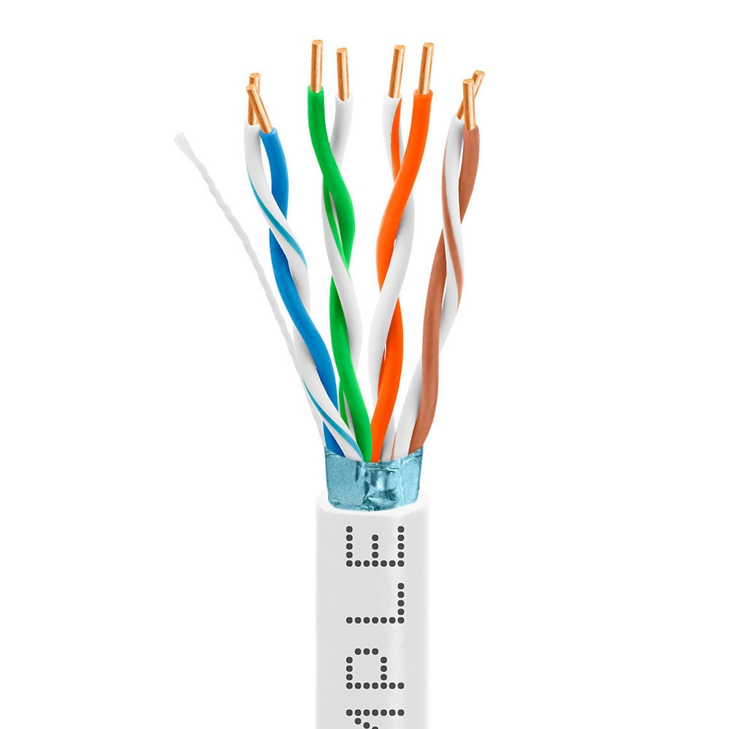
Performance Enhancements of CAT5e
Key Performance Enhancements:
**Reduced Crosstalk**: CAT5e cables are designed to minimize interference between pairs of wires, improving overall performance.
**Higher Data Rates**: CAT5e supports data rates of up to 1 Gbps, suitable for most modern networking applications.
Real-World Example: In a small office, CAT5e cables provide reliable connectivity for computers, printers, and servers, ensuring smooth data transfer and communication.
Summary: The performance enhancements of CAT5e make it a suitable choice for a wide range of networking applications, providing reliable and efficient connectivity.

Slide 51
Conclusion on Networking Basics
Summary of Key Networking Concepts:
This presentation has covered essential networking concepts, including internetworking, the OSI model, TCP/IP model, internet protocols, and cable categories.
Understanding these concepts is crucial for grasping the complexities of networking and how different elements work together to facilitate communication.
A solid foundation in networking basics is essential for anyone pursuing a career in IT, networking, or related fields.
Summary: Networking is a vital aspect of modern communication, and understanding its fundamentals is essential for success in the field.

Slide 52
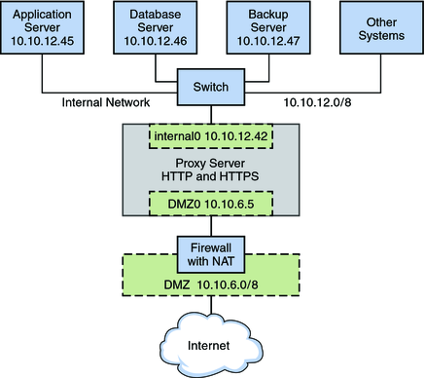
Additional Resources for Further Learning
Recommendations for Further Exploration:
**Textbooks**: "Computer Networking: A Top-Down Approach" by James Kurose and Keith Ross.
**Online Courses**: Platforms like Coursera and edX offer networking courses covering various topics.
**Websites**: The Cisco Networking Academy and CompTIA resources provide valuable information and training for networking professionals.
Summary: Utilizing additional resources can enhance understanding and knowledge of networking topics, supporting continued education and professional development.

